Slide 1
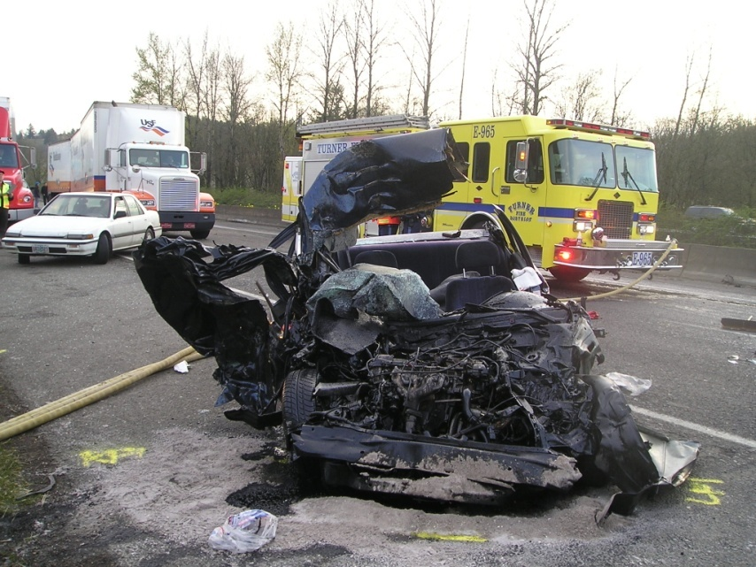



Session 2
Drugs in Society and in Vehicle Operation

Slide 2
Learning Objectives
Define the term “drug” in course context
Name the seven drug categories
State incidence of drug use
State incidence of drug involvement in motor vehicle crashes and other driving incidents

Slide 3
What is a “Drug”?
Working Definition of “Drug”:
“Any substance that, when taken into the human body, can impair the ability of the person to operate a vehicle safely.”

Slide 4
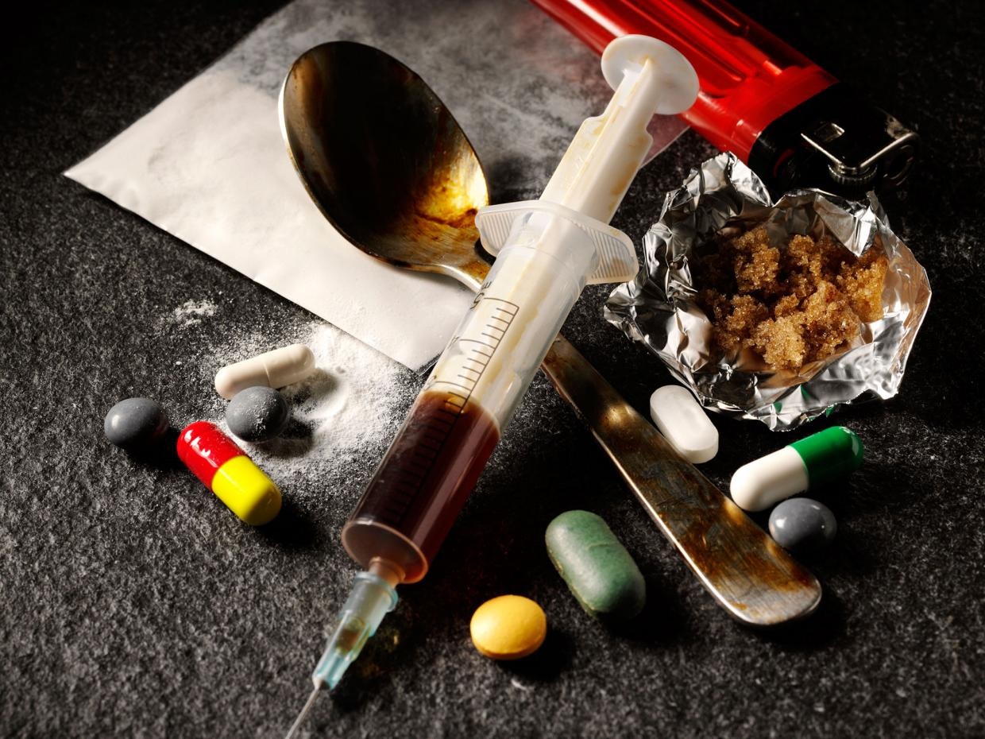
What is a “Drug”?

Slide 5
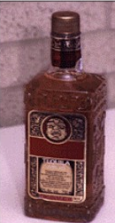
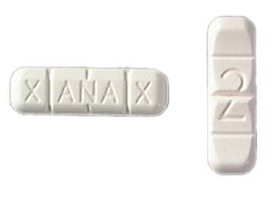
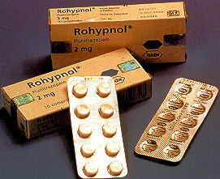

Central Nervous System Depressants
Examples:
Alcohol
Barbiturates
Antidepressants
Anti-Anxiety Tranquilizers

Slide 6
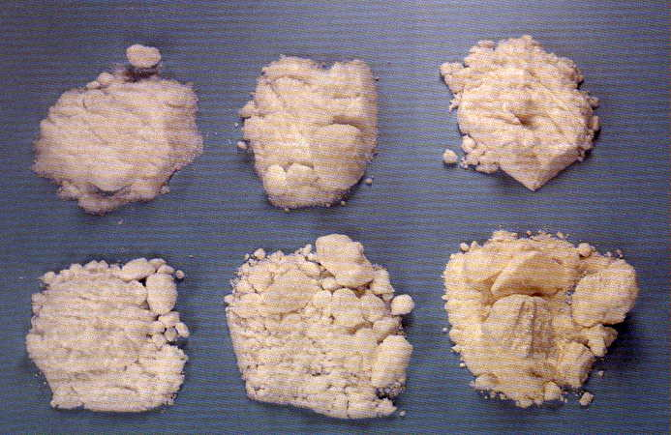
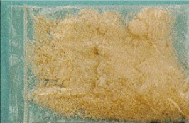
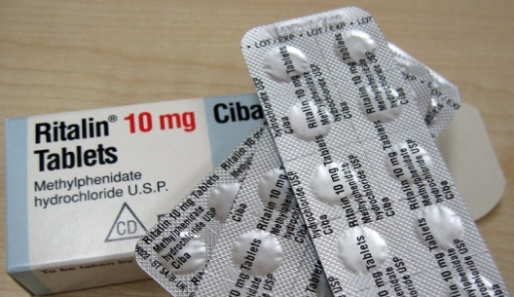
Central Nervous System Stimulants
Examples:
Amphetamine
Cocaine
Methamphetamine
Ritalin

Slide 7

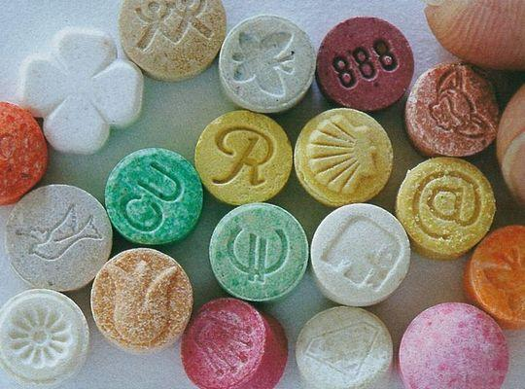
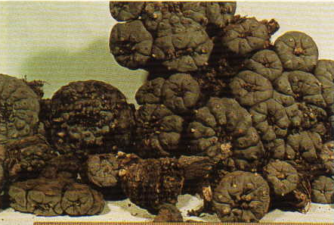
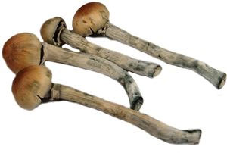
Hallucinogens
Examples:
LSD
MDMA (Ecstasy)
Peyote
Psilocybin

Slide 8

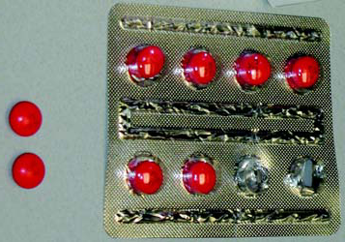
Dissociative Anesthetics
Examples:
PCP (Phenyl Cyclohexyl Piperidine)
Ketamine
Dextromethorphan

Slide 9
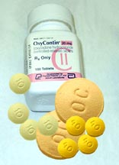
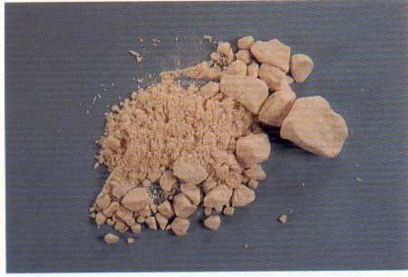
Narcotic Analgesics
Examples:
Codeine
Fentanyl
Heroin
Methadone
Morphine
OxyContin®

Slide 10
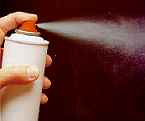
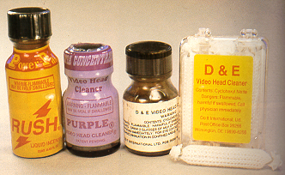
Inhalants
Examples:
Volatile Solvents
(Various Glues, Gasoline, Paint, etc.)
Aerosols
(Hairspray, Insecticides, etc.)
Anesthetic Gases
(Nitrous Oxide, Amyl Nitrite, etc.)

Slide 11
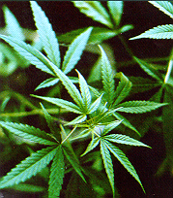
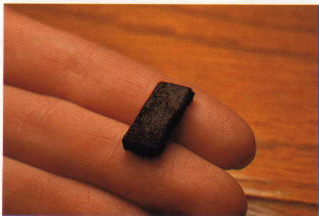
Cannabis
Active ingredient:
Tetrahydrocannabinol (THC)
Examples:
Marijuana
Hashish
Marinol

Slide 12
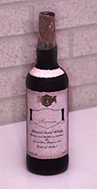
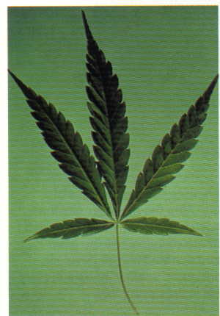
Drug Combinations
+

Slide 13
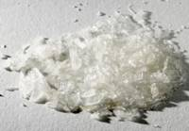
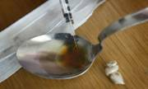
Drug Combinations
+

Slide 14
Incidence and Characteristics of Drug Use in America
37.3 million Americans 12 or older were current illicit drug users
Marijuana most commonly used – 32.8 million current users
5.2 million current users of non-medical psychotherapeutic drugs

Slide 15
Drug-Impaired Driving Facts
About 11.8 million people aged 12 years and older admitted driving under the influence of illicit drugs in the past year.

Slide 17

NHTSA Drug and Alcohol Crash Risk Study

Slide 18
NHTSA Drug and Alcohol Crash Risk Study Key Findings
0.08
Four Times
More Likely to Crash
0.15
12 Times
More Likely to Crash
Marijuana Users
1.25 Times
More Likely to Crash

Slide 19
Questions?

Slide 20
Test Your Knowledge
What does the term “drug” mean, as it is used in this course?
What are the seven categories of drugs?
To which category does alcohol belong?
To which category does Cocaine belong?

Slide 21
Test Your Knowledge
What does “polydrug use” mean?
What is a “Speedball?”
In the 2013-2014 National Roadside Survey of Alcohol and Drug Use by Drivers, ______% of drivers tested positive for at least one illegal drug.

